Slide 1
The event will begin momentarily.
This event is being recorded
Captions are available by clicking the CC icon in the Zoom toolbar below
ASL is provided
Presentation materials are available at:
www.access-board.gov

Slide 2

Equity in Healthcare for People with Disabilities

Slide 3
Agenda
Relevant Federal Standards and Resources for Healthcare Accessibility
Medical Diagnostic Equipment: Bobby Stinnette, U.S. Access Board
Buildings and Sites: Bill Botten, U.S. Access Board
Information & Communication Technology: Kathy Eng, U.S. Access Board
Status of Enforceable Accessible Medical Equipment Standards
Ana Torres-Davis, National Council on Disability (NCD)
Designing Inclusive Healthcare Environments
Bill Zellmer, Sutter Health Care
Communication Access in Healthcare Environments
Zainab Alkebsi, National Association of the Deaf

Slide 4
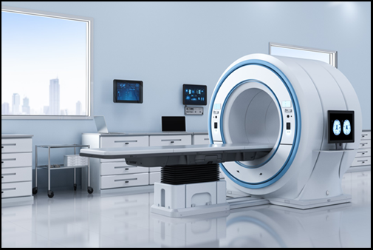
Medical Diagnostic Equipment
Standards address diagnostic equipment in:
Physicians' offices
Clinics
Hospitals
Rehabilitation facilities
Optometrists
Dentists
Other medical settings

Slide 5
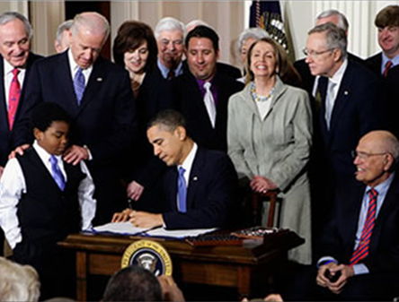
Rehabilitation Act §510
Mandates the Access Board to issue minimum technical criteria for accessible medical diagnostic equipment in consultation with the FDA
Affordable Care Act amends the Rehabilitation Act to address access to MDE
(March 23, 2010)

Slide 6
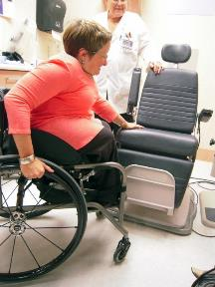
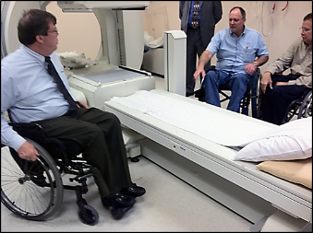
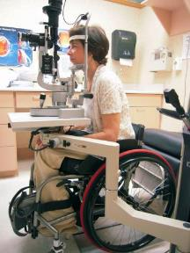
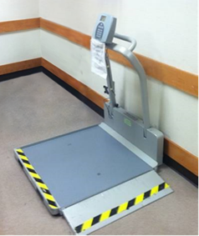
Diagnostic Equipment Includes:
Examination tables
Examination chairs (including those used for dental or optical exams)
Weight scales
Radiological equipment
X-ray machines
MRI, CT Scan
Mammography equipment
Other MDE

Slide 7
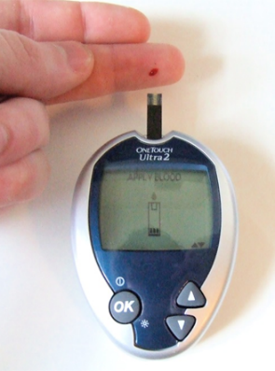
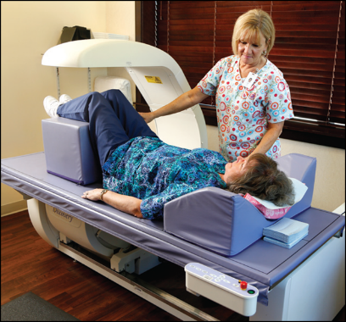
Standards do not cover:
Personal devices
Blood glucose monitors
Positioning aids
Wedges
Surgical and medical instruments
Stethoscopes
Forceps, scalpels

Slide 8
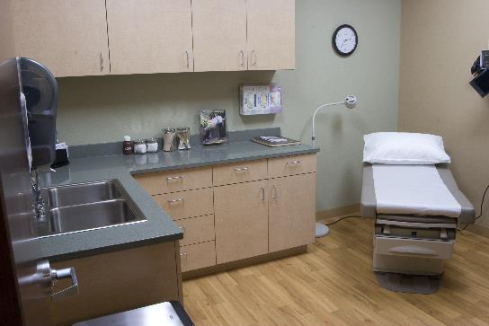
Medical Diagnostic Equipment Standards
Standards are currently voluntary.
Other agencies can adopt the standards (example - DOJ under the ADA).
Available for use by other entities as a standard (example – healthcare systems and providers, state and local governments).
Could be used by FDA to verify labelling claims.

Slide 9
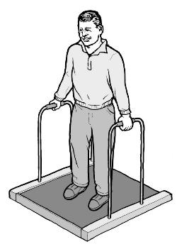
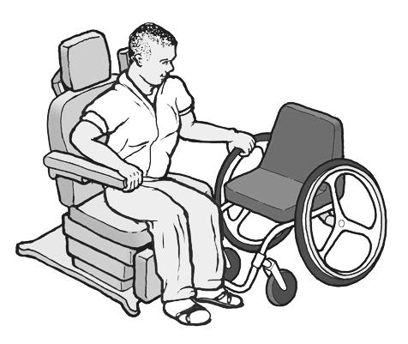
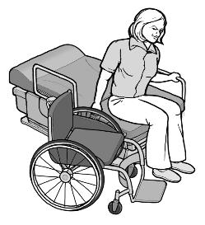
Technical Provisions
Based on patient position for use
Supports
Communication
Operable parts
Supine, Prone, or Side Lying
Seated
Standing

Slide 10
Medical Diagnostic Equipment Standards
The Standards for Accessible Medical Diagnostic Equipment can be found at:
https://www.access-board.gov/mde/

Slide 11

Guidance on Prescription Drug Container Labels
Advisory (non-binding) guidance developed by a stakeholder working group
Best Practices for All Formats
Communication
Provide options
Quality control
Maintain patient privacy
No Surcharge (extra fee)
https://www.access-board.gov/rx.html

Slide 12

Bill Botten Senior Accessibility Specialist US Access Board Americans with Disabilities Act (ADA) & Architectural Barriers Act (ABA) Standards
Bill Botten
Senior Accessibility Specialist
US Access Board

Slide 13


All Types of Health Care Facilities Covered
Clinics, doctors' offices, dental offices, and other professional offices of healthcare providers
Hospitals, Rehabilitation Facilities, Psychiatric Facilities and Detoxification Facilities
Long-term Care Facilities

Slide 14
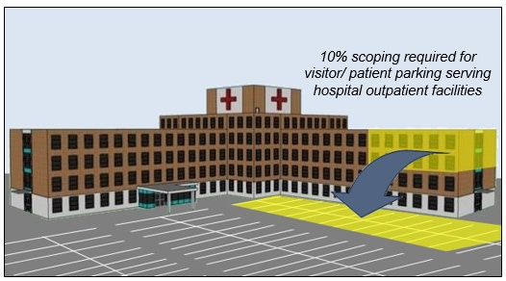
Covered Spaces/Elements
Parking
Accessible routes
Entrances
Exam rooms and other public or common use areas
Patient bedrooms
Toilet and bathing rooms
Service counters

Slide 15
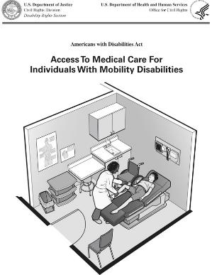
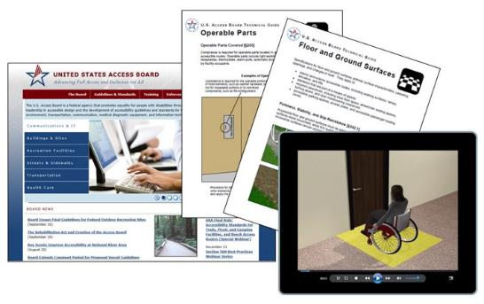
Available Resources
Guide to the ADA & ABA Standards (access-board.gov)
Department of Justice Guide (ada.gov)

Slide 16

Section 508 Standards for Information & Communication Technology (ICT)
Kathy Eng Senior ICT Accessibility Specialist US Access Board

Slide 17
ICT Standards
Section 508 of Rehabilitation Act
ICT procured, developed, maintained, or used by federal agencies (can be a resource for other entities)
Examples of ICT: computers, information kiosks and transaction machines, multifunction office machines, software, applications, web sites, videos, and electronic documents.

Slide 18

ICT Standards for Accessibility
Electronic Content
Hardware
Software
Support Documentation and Services

Slide 19
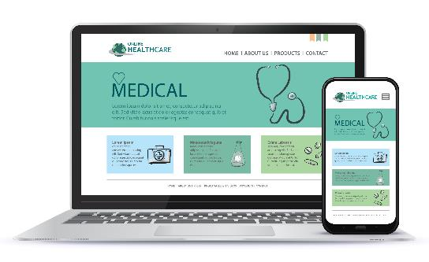
Healthcare Electronic Content
Web sites and apps
Forms (appointment requests, new patient, payment, etc.)
Documents (patient history, test results, etc.)
Chat communication
Intranets covered also

Slide 20

Healthcare Software
Virtual Meeting Platforms
Telemedicine healthcare appointments
Accessible instructions
Meeting controls
Chat features, screen share
Support captions and audio descriptions

Slide 21
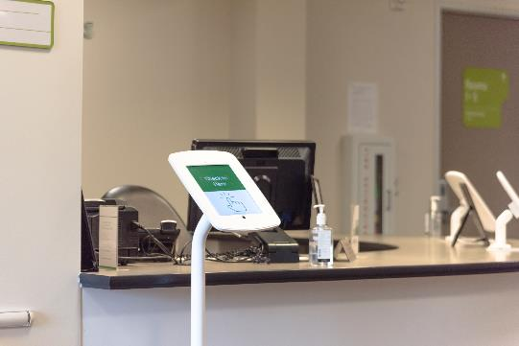

Healthcare Hardware
Check-in Kiosk
Tablet with patient form

Slide 22
ICT Accessibility Resources
Access Board Technical Assistance
508@access-board.gov
Section 508 Standards
www.access-board.gov/ict
How To Meet WCAG (Quickref)
www.w3.org/WAI/WCAG21/quickref/
www.section508.gov

Slide 23
QUESTIONS?
You may type and submit questions in the Q&A Area

Slide 24

Enforceable Accessible Medical Equipment Standards
Ana Torres-Davis National Council on Disability (NCD)

Slide 25

Findings and Recommendations from NCD’s Report on Accessible Medical Equipment
Ana Torres-Davis
Senior Attorney-Advisor

Slide 26
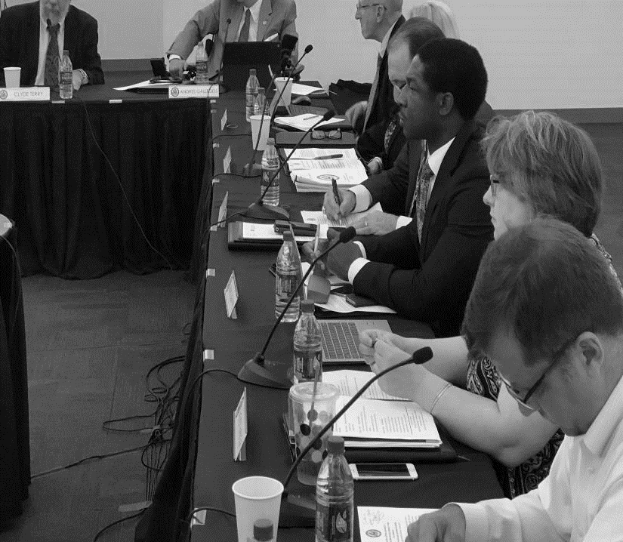

A Federal Voice for People with Disabilities
Advisor to the President, Administration, Congress & federal agencies
9 Presidential & Congressional appointees, and a professional staff of 12

Slide 27

A Federal Voice for Equitable Healthcare for People with Disabilities
2009: The Current State of Health Care for People with Disabilities
2019: Bioethics Report Series – Ethics and Medical Decision-making regarding Patients with Disabilities

Slide 28
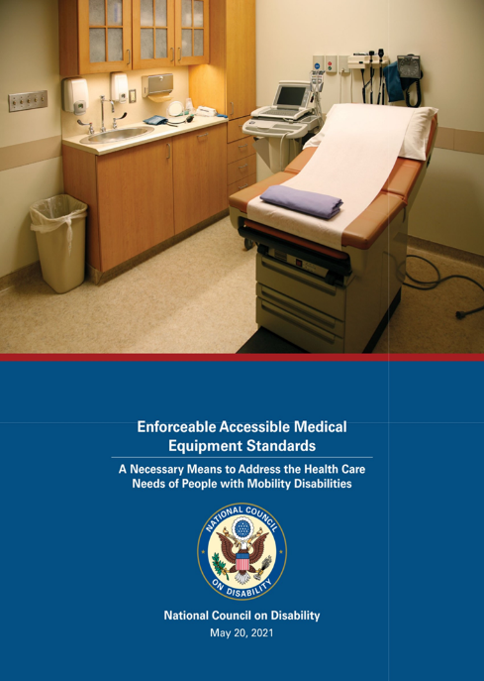
May 2021 Report on Accessible Medical Equipment Standards
Most recent report in NCD’s healthcare and health equity series

Slide 29
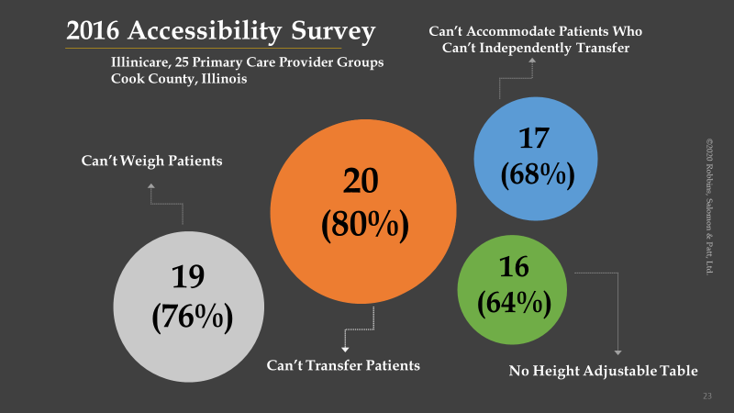
2016 Accessibility Survey

Slide 30

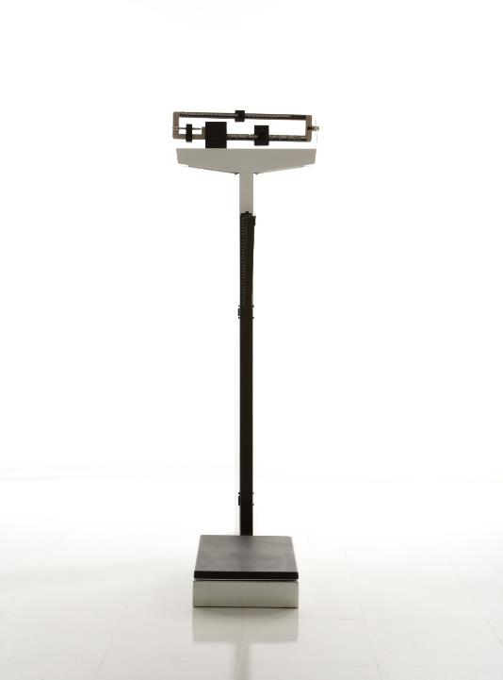
Physical Barriers: Inaccessible Weight Scales
30

Slide 31
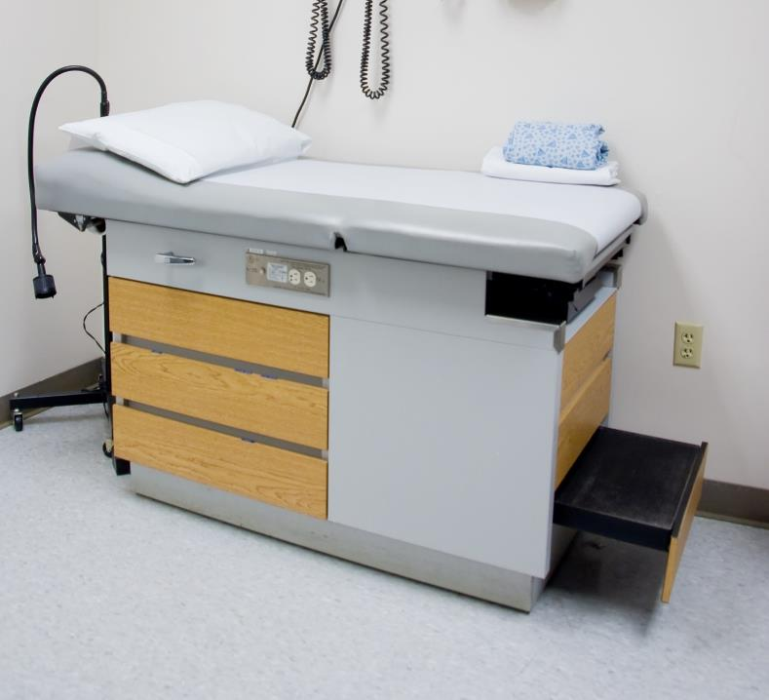
Physical Barriers: Examination Tables

Slide 32
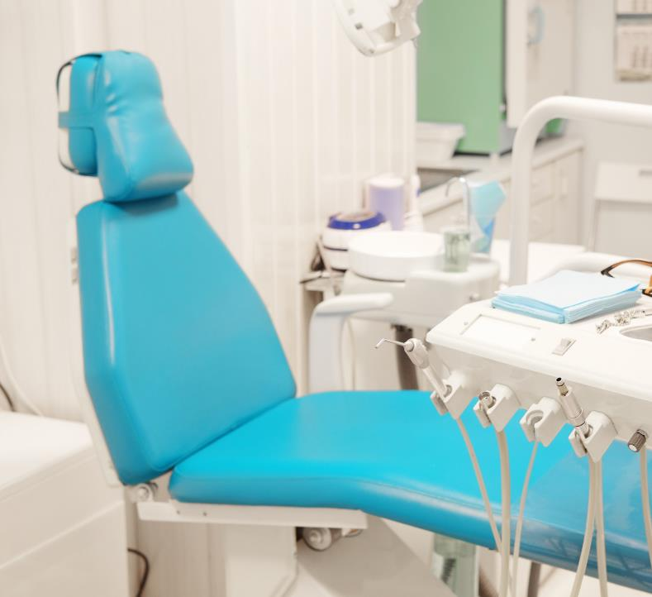
Physical Barriers: Examination Chairs

Slide 33
Key Finding: Inequities & Health Disparities
People with disabilities experience significant health care disparities due in part to lack of physical access, leading to delayed care, high-cost utilization, loss of dignity, and poorer health outcomes.

Slide 34
Health Disparities
Experience difficulties or delays in getting the healthcare needed
Persons with disabilities are more likely to . . .
Be overweight or obese, have high blood pressure & experience symptoms of psychological distress

Slide 35
Health Disparities
Not have had an annual dental visit
Persons with disabilities are more likely to . . .
Not have had a mammogram in the past 2 years
Not have had a Pap test in the past 3 years

Slide 36
Health Care Inequities
Not have had a complete & thorough annual physical examination
Persons with paralysis & mobility disabilities are more likely to . . .
Not be accurately weighed for years
Be examined while remaining in their devices

Slide 37
Health Care Inequities
Be denied inpatient admission for mental health treatment
Persons with paralysis & mobility disabilities are more likely to . . .
Not receive diagnostic test or exams for breast cancer screenings
Not receive bone density screenings
Not receive colorectal cancer screenings timely

Slide 38
Key Finding:
While accessible MDE is required under the ADA, Sections 504 and 1557, the lack of enforceable MDE standards allows for continued, widespread discrimination in health care for people with mobility disabilities. health care for people with mobility disabilities.

Slide 39
Key Recommendations
To the U.S. Department of Justice, Civil Rights Division
To the U.S. Department of Health and Human Services (HHS), Office for Civil Rights
To the HHS, Office of the National Coordinator for Health information Technology
The Accreditation Council on Graduate Medical Education

Slide 40


Access to healthcare is a civil right

Slide 41
QUESTIONS?
You may type and submit questions in the Q&A Area

Slide 42

Inclusive Health Care Design
Bill Zellmer
Sutter Health Care

Slide 43


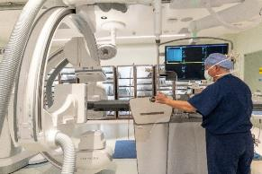
Sutter Health – Case Studies and Examples
Bill Zellmer AIA, Certified Access Specialist
Sutter Health Program Manager – Physical Access Compliance and Regulatory Affairs
Sacramento, CA

Slide 44
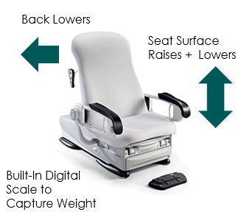
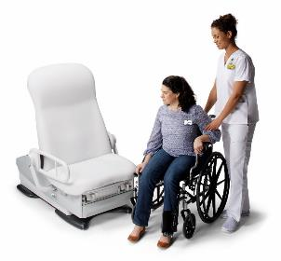
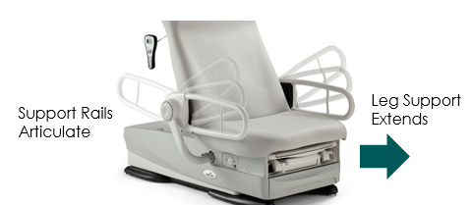
Accessible Exam Chairs
Best Practices:
Provide adjustable height medical equipment
Provide exam chairs that capture weight

Slide 45
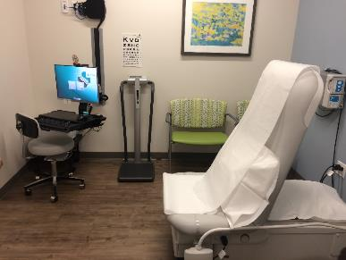
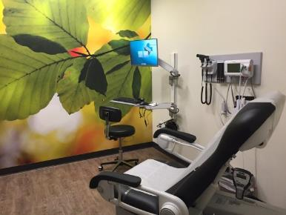
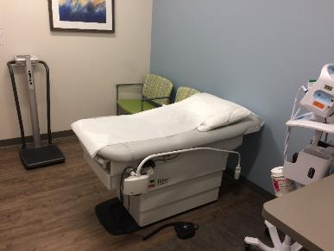
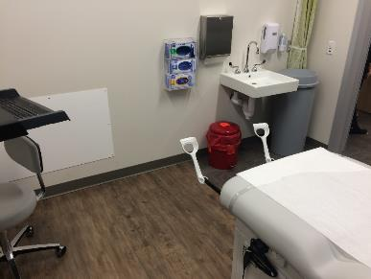
Examples

Slide 46
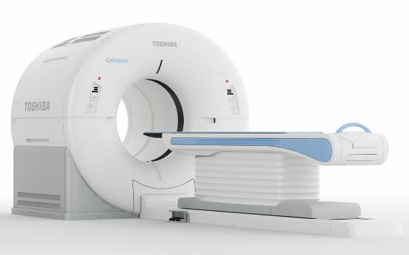
Standard Medical Floor Plans
Notes:
46

Slide 47
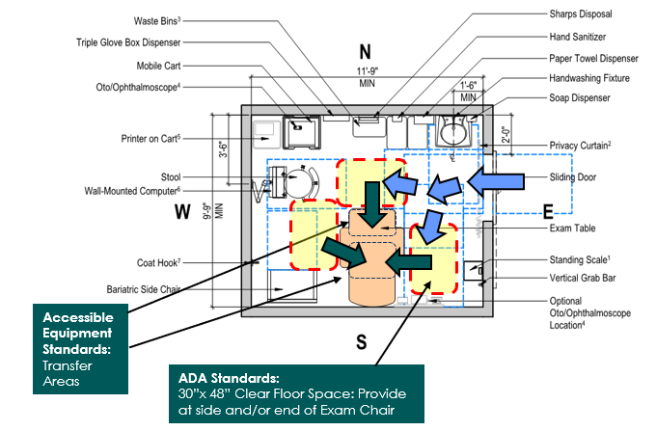
General Exam Room
Best Practices:
Create spaces as big as possible for transfers, for both left + right-side bias
Notes:
47

Slide 48
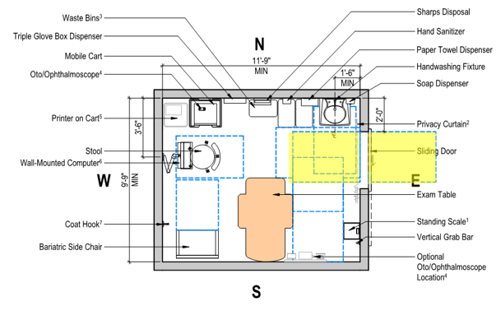
General Exam Room
Door Maneuvering Clearance – Barn Door
Door Width x 48” Deep
Notes:
48

Slide 49
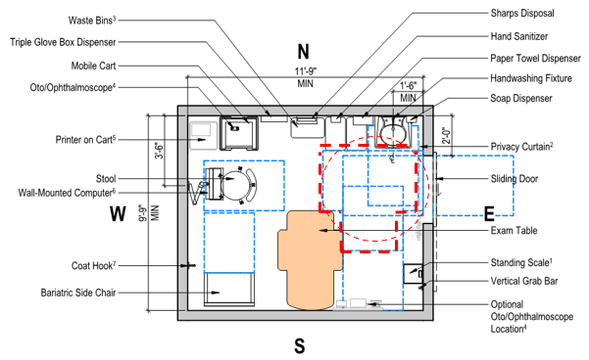
General Exam Room
60” Turning ‘T’ or 60” Turning Circle
Notes:
49

Slide 50
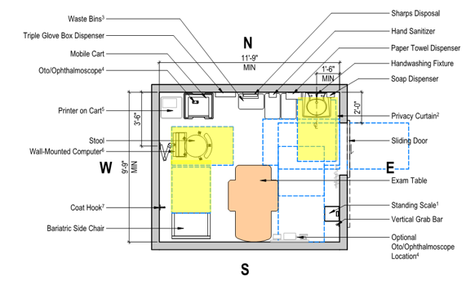
General Exam Room
30” x 48” Clear Floor Space at Each Fixture
Notes:
50

Slide 51
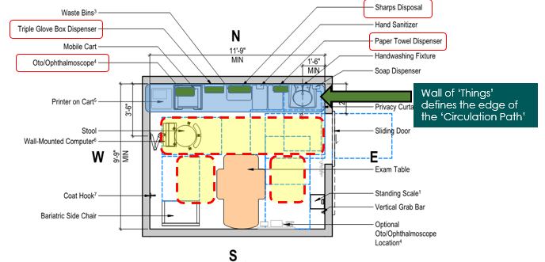
General Exam Room
PROTRUDING OBJECTS: Confirm that there are no objects ‘Protruding into the ‘Circulation Paths’
‘Circulation Paths’ (Yellow Areas) defined
Notes:
51

Slide 52
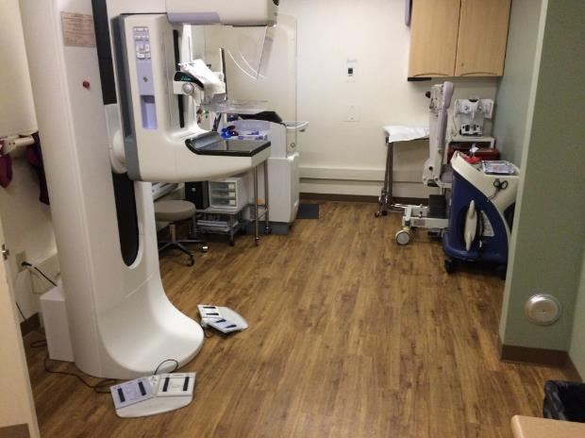
Mammography Room
Notes:
52

Slide 53
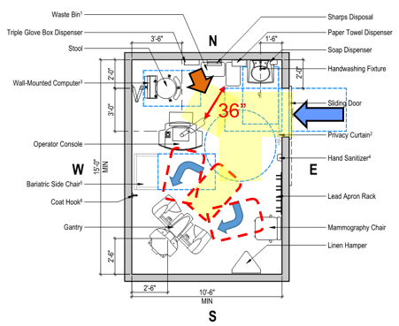
Mammography Room
30” x 48” Clear Floor Space at Point Access to the Equipment
Angled Access if Needed
Access to Operator Console, requires a 36” wide ‘accessible route’
Notes:
53

Slide 54
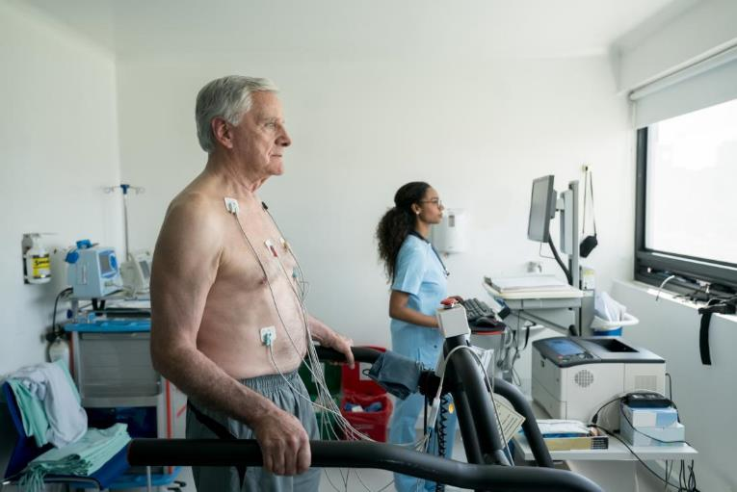
Stress Test Room
Notes:
54

Slide 55
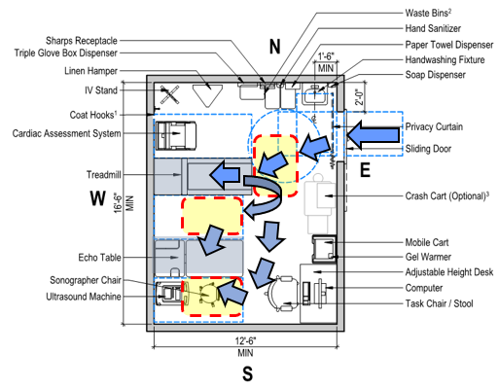
Stress Test Room
30” x 48” Clear Floor Space at Treadmill
Provide 30” x 48” Clear Floor Space at Table
Access Aisle at Side-2 is provided, w/ equip in the aisle...can be moved as needed
Notes:
55

Slide 56
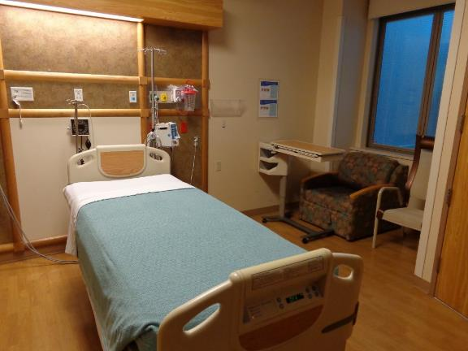
Accessible Patient Bedroom
Notes:
56

Slide 57
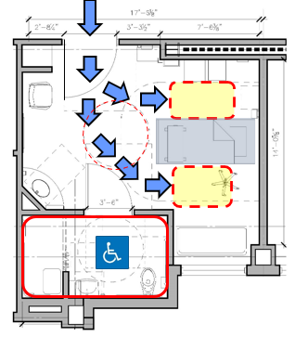
Accessible Patient Bedroom
Clear Floor Space: 30” x 48” Req’d at both sides of bed
60” Turning Circle
Notes:
57

Slide 58
CT Scan Room
Notes:
58

Slide 59
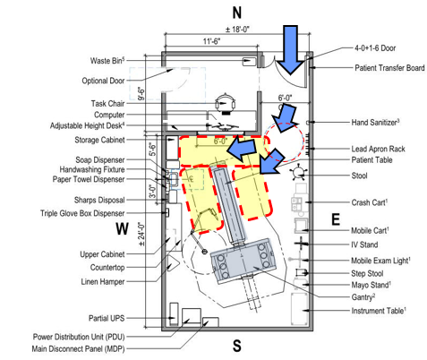
CT Scan Room
Provide a 36” ‘Accessible Route’ to both sides of the table
Medical codes often require a 36” clearance between walls and equipment
Notes:
59

Slide 60
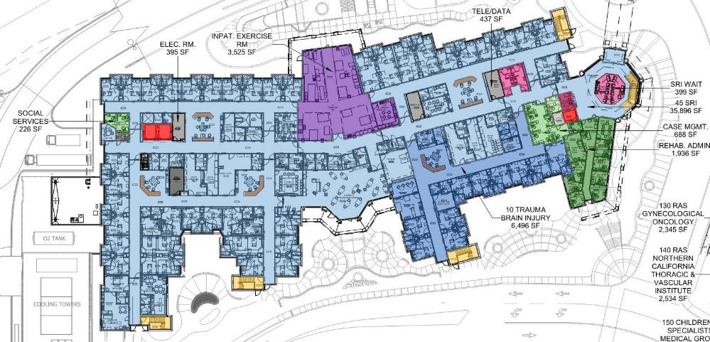
Rehabilitation Facilities
Notes:
60

Slide 61
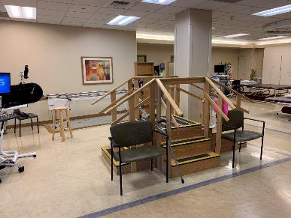
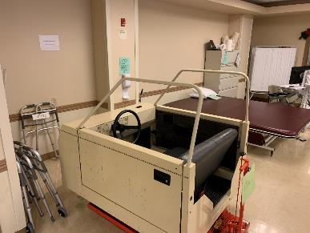
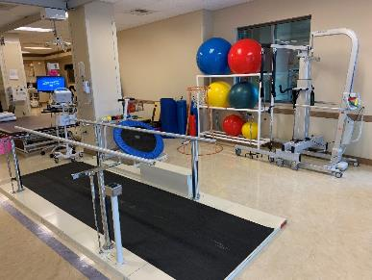
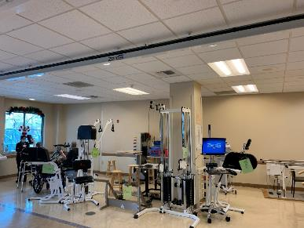
Physical Therapy - Gym
Notes:
61

Slide 62
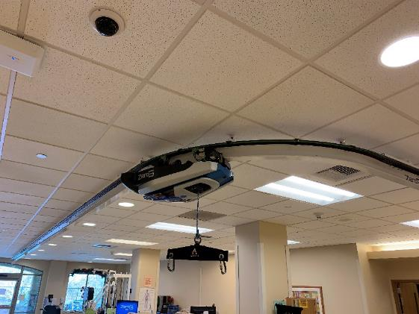

Overhead Lifts at Physical Therapy Gym
Notes:
62

Slide 63




Outdoor Training Spaces
Notes:
63

Slide 64


Activities of Daily Living (ADL)
Training Kitchen – w/ Patient Lift and Track
Notes:
64

Slide 65


Overhead Lifts at Patient Bedrooms
Notes:
65

Slide 66




Independent Living Unit – In the Hospital
Notes:
66

Slide 67




Communication Features – ‘Point Cards’
Notes:
67

Slide 68


ASL On-Site + Phone & Video Interpreter Services
Notes:
68

Slide 69

Solutioning
Notes:
69

Slide 70

Solutioning
Furniture / Equipment:
Create a ‘Home Base’ for all furniture and equipment that does not intrude on any required accessible routes, turning circles or other clearances
Notes:
70

Slide 71

Solutioning
Notes:
71

Slide 72
QUESTIONS?
You may type and submit questions in the Q&A Area

Slide 73

Communication Access in Healthcare Environments
Zainab Alkebsi
Policy Counsel, NAD

Slide 74
Inequity in Access to Medical Facilities
Failures to provide communication access:
Frequent refusals to provide auxiliary aids and services
Inappropriate claims of undue burden
Overreliance on VRI
Failure to vet quality of auxiliary aids and services

Slide 75
Explosion of and Overreliance on VRI
Many medical facilities have stopped providing in-person interpreters and instead now only provide Video Remote Interpreting (VRI)
Limiting to one option = inappropriate
Many adverse situations where VRI was involved
VRI should be a last resort, not the sole option
Advantages of on-site interpreters over VRI:
More mobility
Greater access to visual and auditory cues in the room
No loss of connection due to malfunctions
NAD Position Statement on VRI

Slide 76
Telehealth
Lack of Accessibility Features on Telehealth Platforms
Relay workaround issues:
Two devices
Sufficient bandwidth to handle two simultaneous video calls
Split attention
Lack of context (interpreter/captioner is unable to see the main screen)
Quality issues
Same screen = vital

Slide 77
Impact of Inaccessible Telehealth
Remote access – greater importance during pandemic
Ability to get care without exposure
Jeopardizes safety of DHOH community who are forced to go in person to overloaded hospitals full of patients, especially during current surge
Inaccessible telehealth is tantamount to denying medical care

Slide 78
Telehealth Solutions
NAD Position Statement on Telehealth Access – Provider Version
NAD Position Statement on Telehealth Access – Consumer Version
Build platforms designed with accessibility & consult with DHOH
The NAD has urged the HHS to adopt strict standards for telehealth accessibility and VRI accessibility, and we encourage the Access Board to do the same

Slide 79
Impact of Inequities in Medical Service Access
Bottom line: More facilities fail to provide communication access than do provide access
Consequences: Puts deaf/hard of hearing patients at risk and increases liability for providers
Call to Action: Implement appropriate protocols in consultation with DHOH community

Slide 80
Inequity in Access to Medical Facilities
• Failures to provide communication access:
• Frequent refusals to provide auxiliary aids and services
• Inappropriate claims of undue burden
• Overreliance on VRI
• Failure to vet quality of auxiliary aids and services

Slide 81
Explosion of and Overreliance on VRI
Many medical facilities have stopped providing in-person interpreters and instead now only provide Video Remote Interpreting (VRI)
Limiting to one option = inappropriate
Many adverse situations where VRI was involved
VRI should be a last resort, not the sole option
Advantages of on-site interpreters over VRI:
More mobility
Greater access to visual and auditory cues in the room
No loss of connection due to malfunctions
NAD Position Statement on VRI

Slide 82
Telehealth
Lack of Accessibility Features on Telehealth Platforms
Relay workaround issues:
Two devices
Sufficient bandwidth to handle two simultaneous video calls
Split attention
Lack of context (interpreter/captioner is unable to see the main screen)
Quality issues
Same screen = vital

Slide 83
Impact of Inaccessible Telehealth
• Remote access – greater importance during pandemic
Ability to get care without exposure
• Jeopardizes safety of DHOH community who are forced to go in person to overloaded hospitals full of patients, especially during current surge
• Inaccessible telehealth is tantamount to denying medical care

Slide 84
Telehealth Solutions
•NAD Position Statement on Telehealth Access – Provider Version
•NAD Position Statement on Telehealth Access – Consumer Version
•Build platforms designed with accessibility & consult with DHOH
•The NAD has urged the HHS to adopt strict standards for telehealth accessibility and VRI accessibility, and we encourage the Access Board to do the same

Slide 85
Impact of inequities in Medical Service Access
Bottom line: More facilities fail to provide communication access than do provide access
Consequences: Puts deaf/hard of hearing patients at risk and increases liability for providers
Call to Action: Implement appropriate protocols in consultation with DHOH community

Slide 86
QUESTIONS?
You may type and submit questions in the Q&A Area

Slide 87
Further Information
U.S. Access Board
ta@access-board.gov
www.access-board.gov
(800) 872-2253 (voice)
(800) 993-2822 (TTY)

Slide 88
Thank you for Joining us today.
This concludes our event. This event has been recorded and the recording will be available on the Access Board’s homepage and its YouTube Channel soon.

Slide 89

89

